Slide 1

Day 2
Generative Artificial Intelligence and LLMs

Slide 2
Agenda
Generative AI vs Discriminatory AI
Generative models (GANs and VAEs)
Transformers and LLMs
Deep Learning

Slide 3

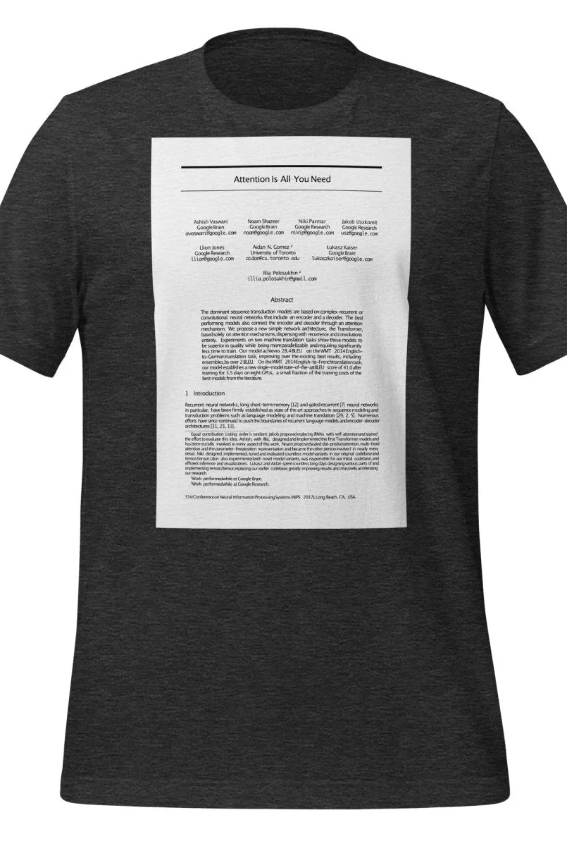
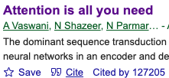
Transformer Architecture

Slide 4
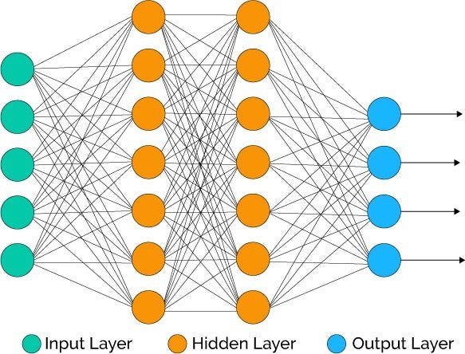
Deep Learning Fundamentals

Slide 5
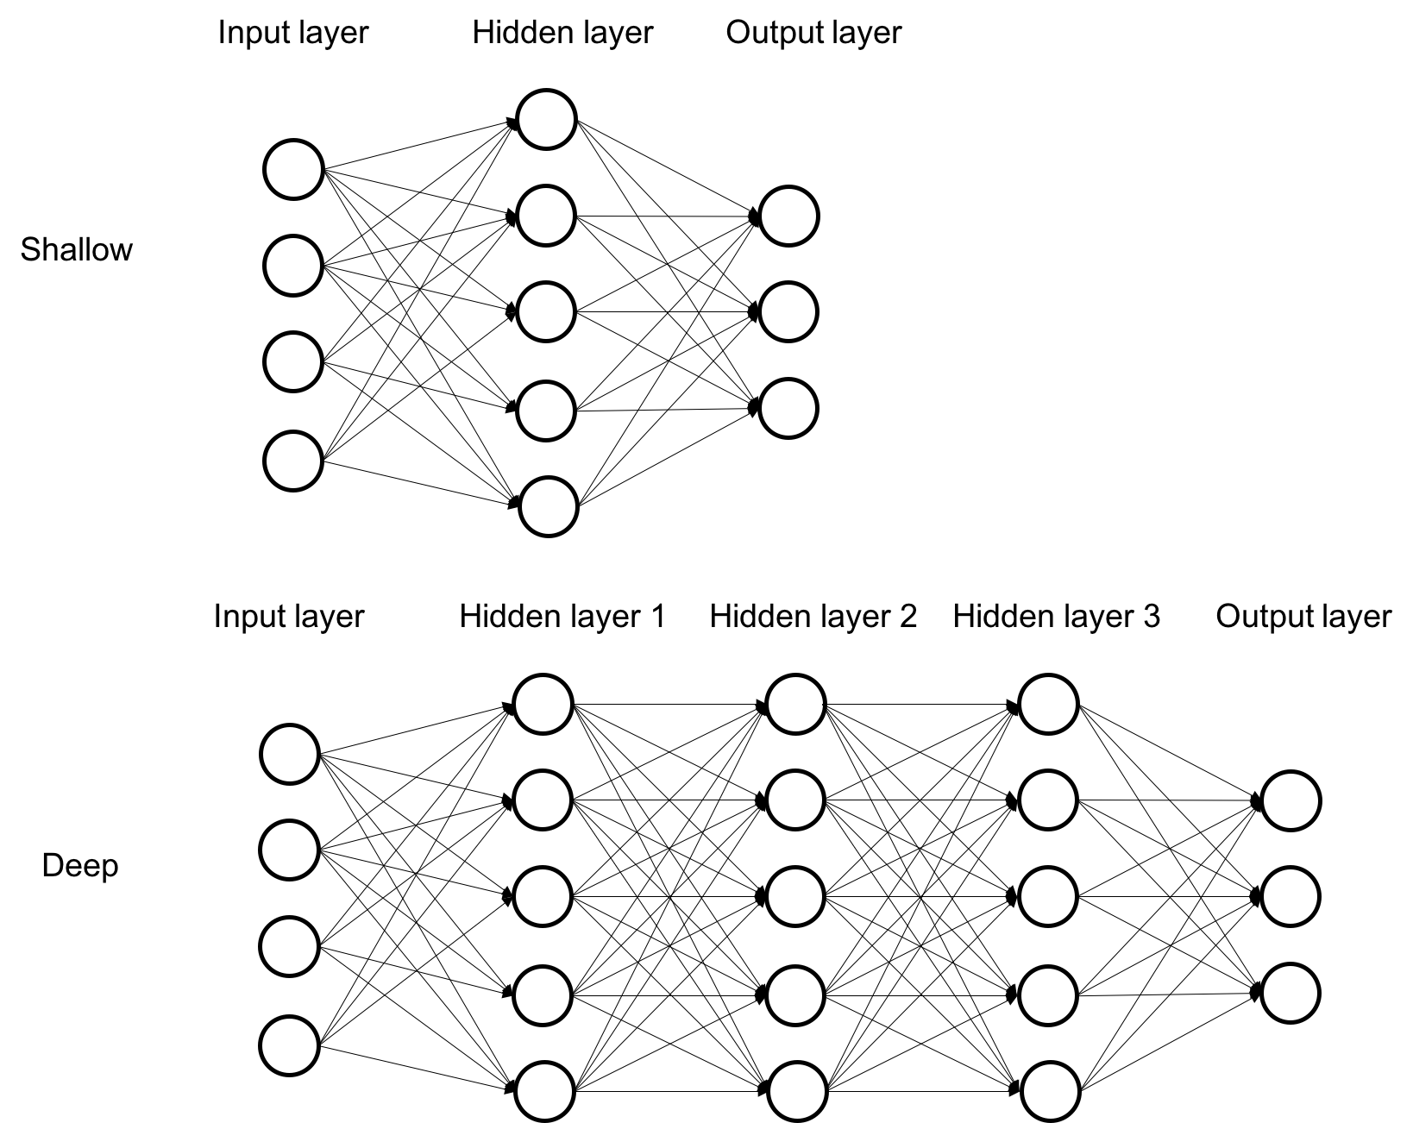
Deep Learning vs Shallow Learning

Slide 6
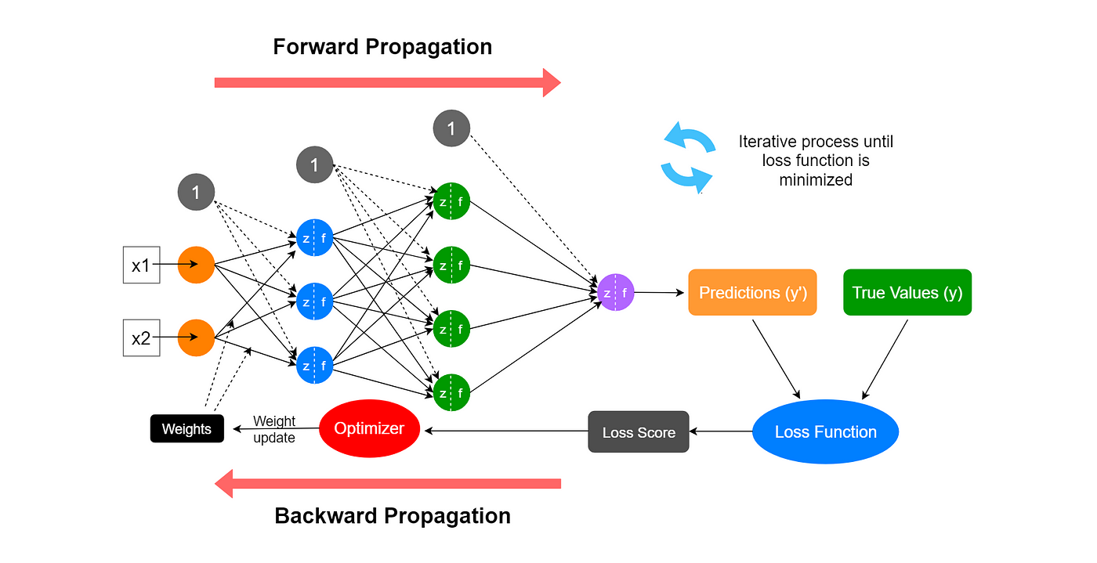

Slide 7
Types of Neural Networks Based on Tasks
Perceptrons
Feedforward Neural Networks
Convolutional Neural Networks
Recurrent Neural Networks (RNNs)
Generative Adversarial Network (GAN)
Transformer Architecture
Variational Autoencoders (VAEs)

Slide 8
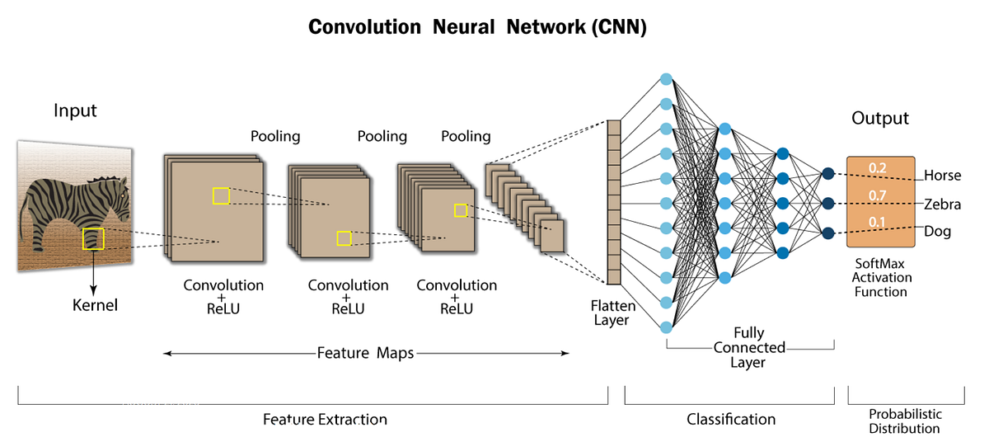
Notes:
https://stanford.edu/~shervine/teaching/cs-230/cheatsheet-convolutional-neural-networks

Slide 9
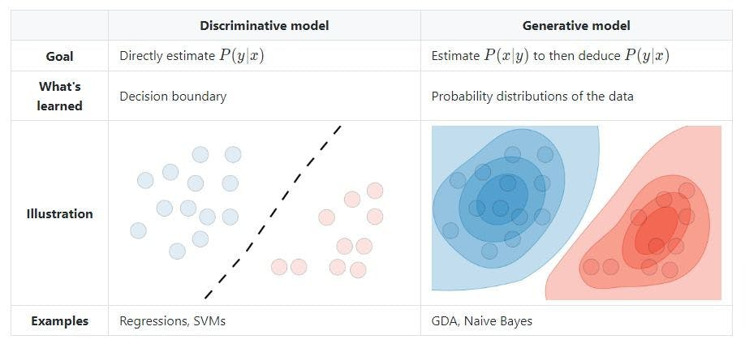
generative model will use the joint probability distribution p(X, Y) of the dataset to capture the whole dataset.
discriminative AI models will only capture the conditional probability distribution p(Y | X) of the dataset.
Notes:
https://www.turing.com/kb/generative-models-vs-discriminative-models-for-deep-learning

Slide 10
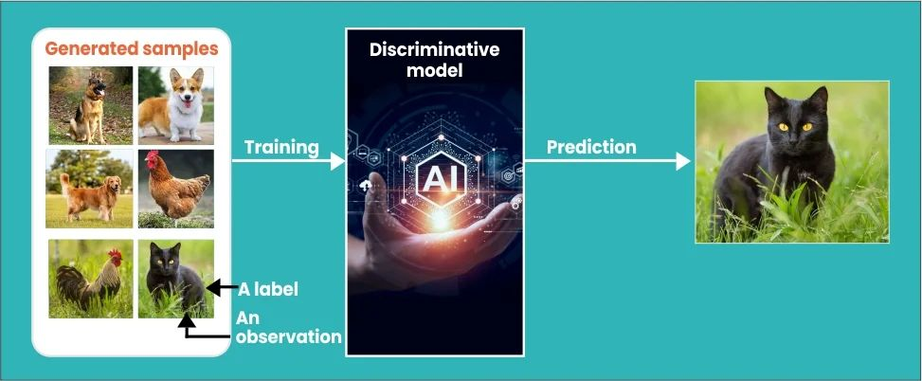
Notes:
https://olibr.com/blog/generative-ai-vs-discriminative-ai-whats-the-key-difference/

Slide 11
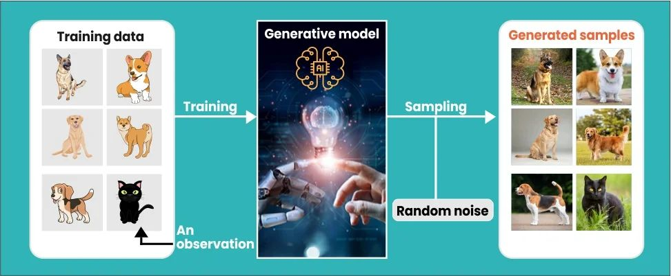
Notes:
https://olibr.com/blog/generative-ai-vs-discriminative-ai-whats-the-key-difference/

Slide 12

Recurrent Neural Networks(RNNs)

Slide 13
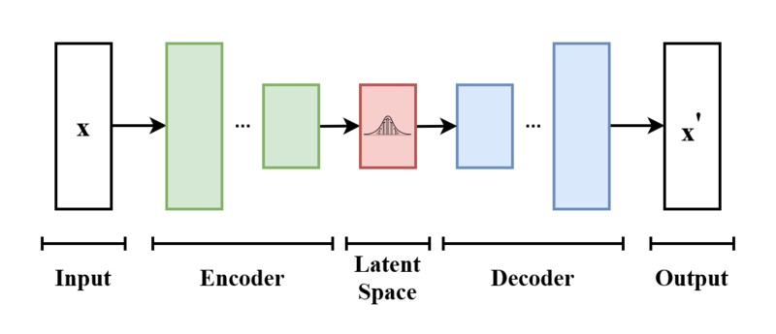
Variational Autoencoders (VAEs)

Slide 14
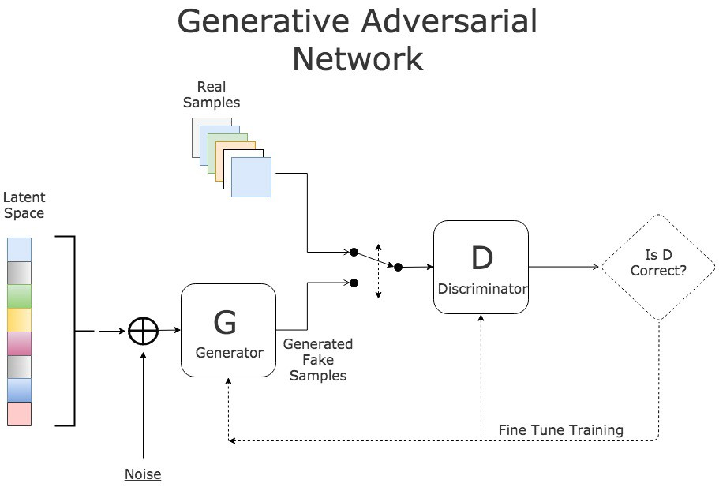
Notes:
https://paperswithcode.com/method/gan

Slide 15
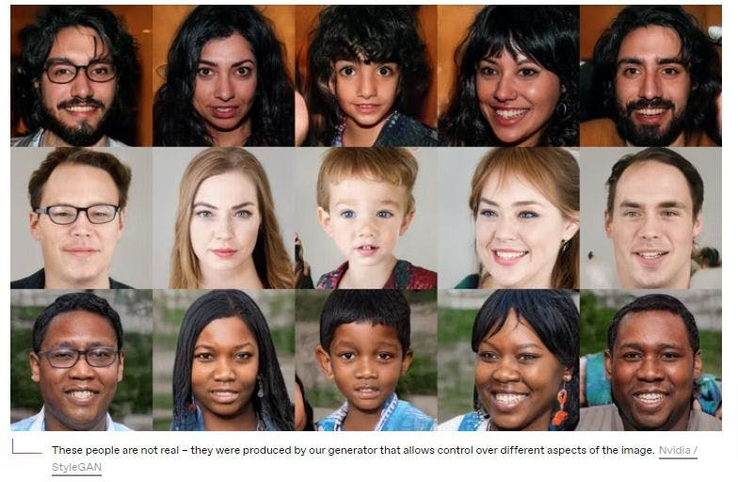
StyleGAN: “This Person Does Not Exist”

Slide 16
Key Limitations of RNNs That Led Transformers
Vanishing and Exploding Gradient Problems
Difficulty in Parallelization
Long-Term Dependencies
“The cat that the dog chased was black.”
“the” ➔ “cat” : short-term dependencies
“cat” ➔ “was black”: long-term dependencies

Slide 17
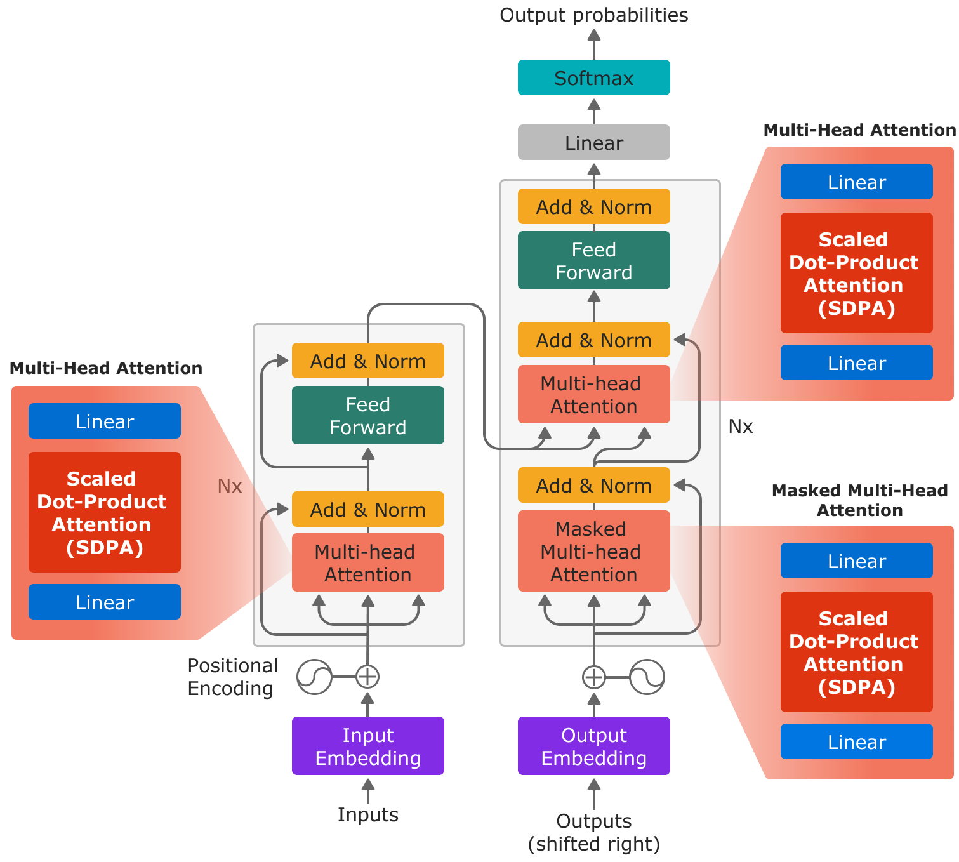
Benefits of Self-Attention in Transformers
Capturing Long-Range Dependencies
Parallelization
Contextual Representations
Scalability
Notes:
https://pytorch.org/blog/accelerating-large-language-models/

Slide 18
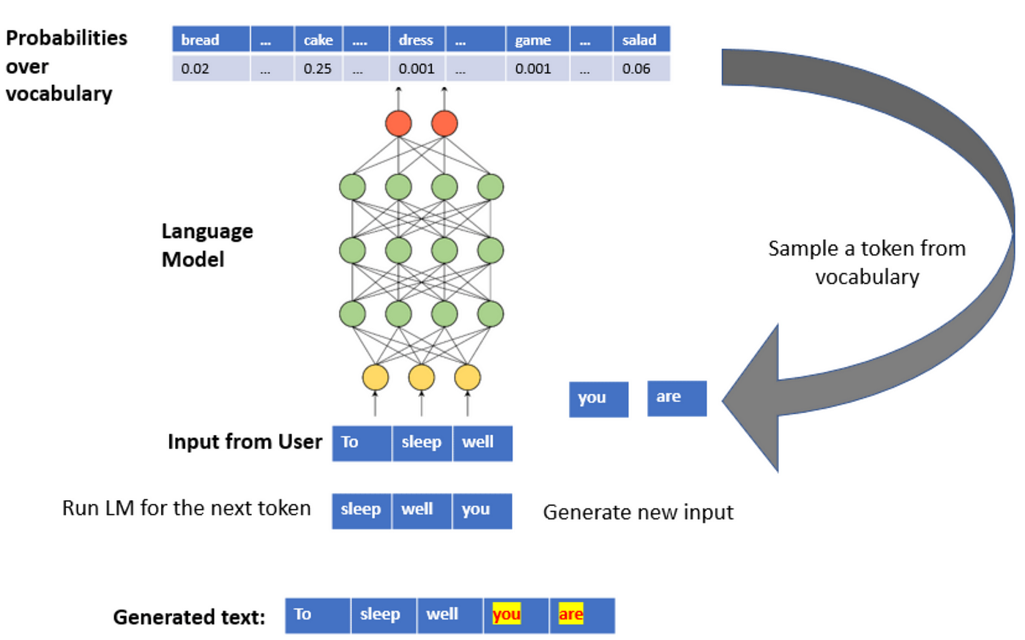

Slide 19
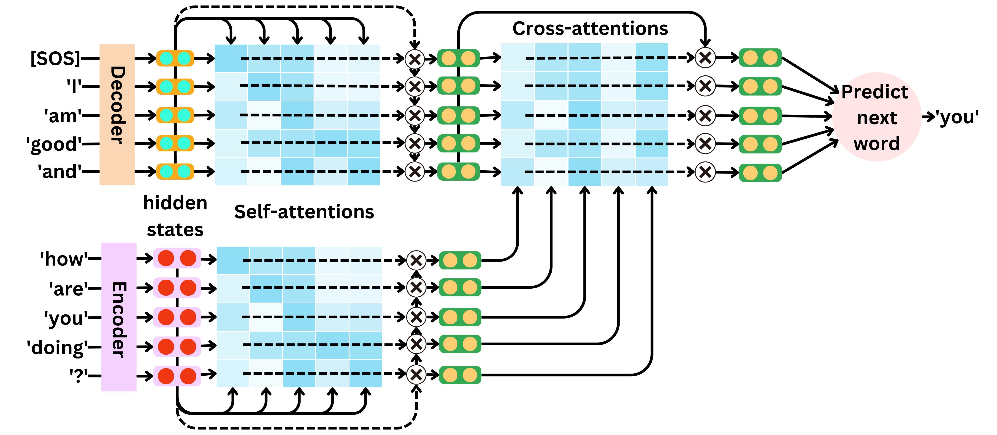

Slide 20
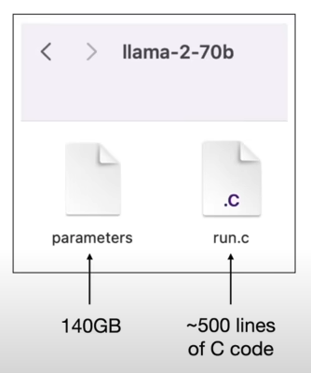
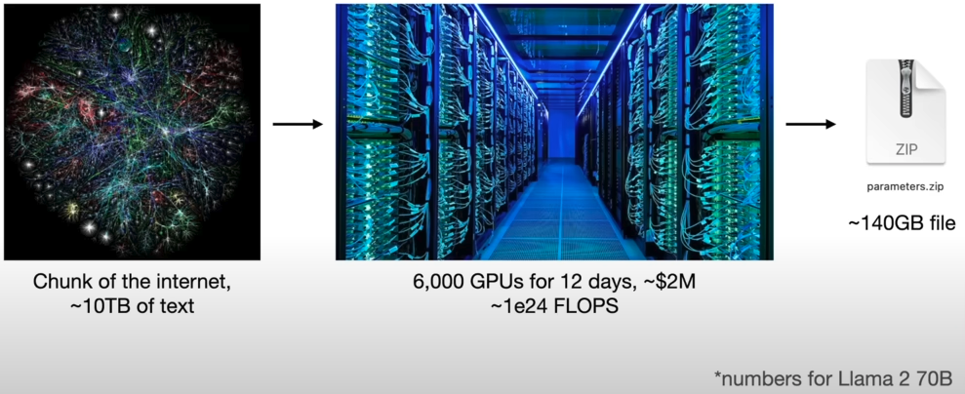
Training Transformer-Based LLM
Notes:
https://www.youtube.com/watch?v=zjkBMFhNj_g

Slide 21
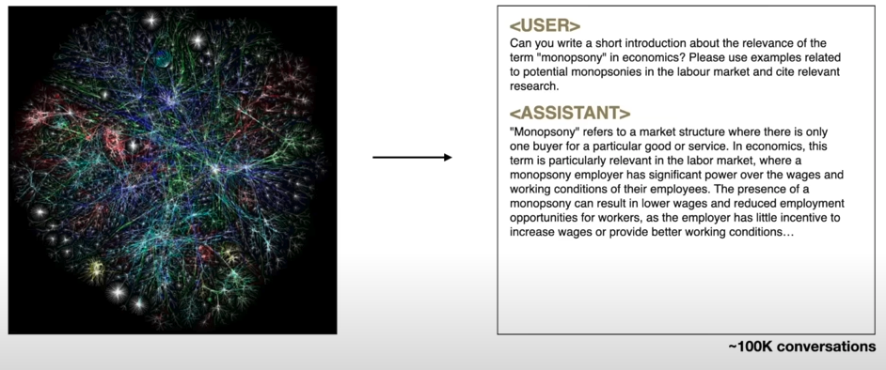
Fine-Tuning

Slide 22
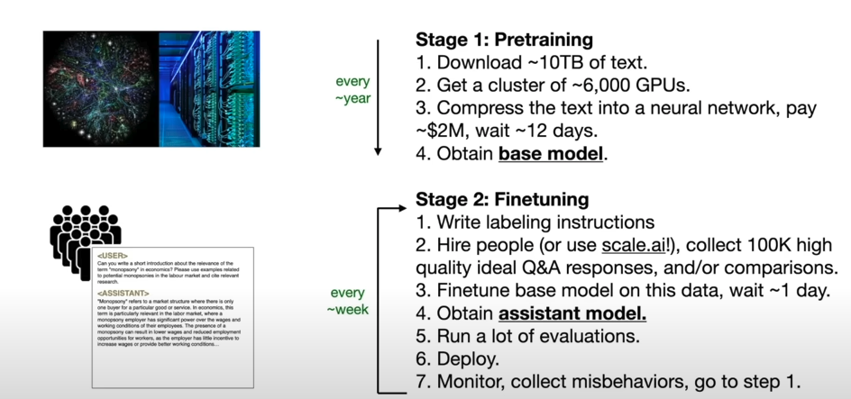
Summary of Training

Slide 23
State-of-the-art Models in Natural Language Processing (NLP)
BERT (Bidirectional Encoder Representations from Transformers)
RoBERTa (Robustly optimized BERT approach)
GPT (Generative Pre-trained Transformer)
T5 (Text-To-Text Transfer Transformer)
BART (Bidirectional and Auto-Regressive Transformers)
ViT (Vision Transformer)(note: computer vision)
LLaMA (Large Language Model Meta AI)

Slide 24
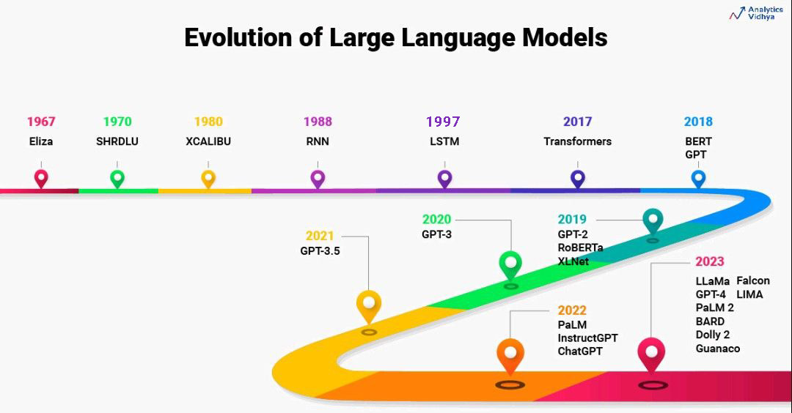
Notes:
https://www.analyticsvidhya.com/blog/2023/07/beginners-guide-to-build-large-language-models-from-scratch/

Slide 25
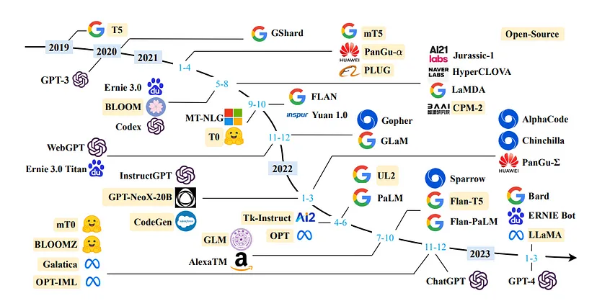
Notes:
https://www.linkedin.com/pulse/future-large-language-models-evolution-specialization-shekhar-meena/

Slide 26
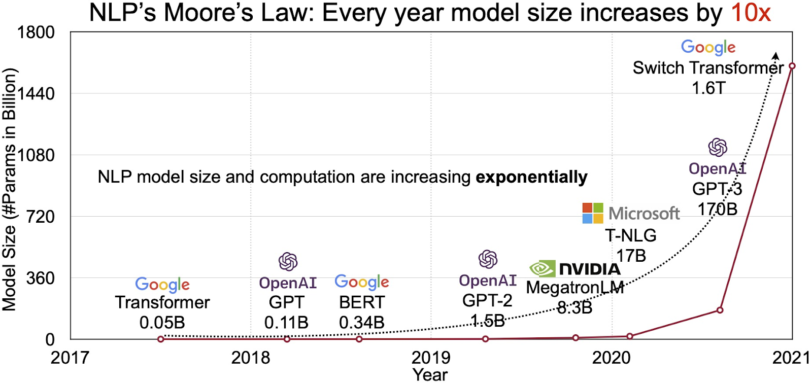
Notes:
https://www.labellerr.com/blog/an-introduction-to-large-language-models-llms/

Slide 27
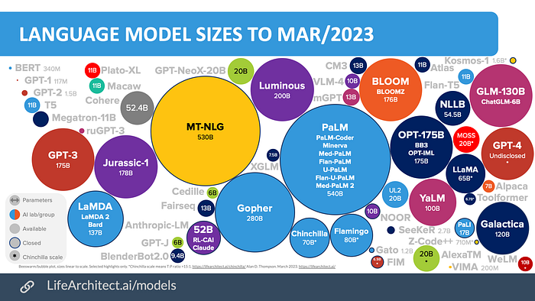

Slide 28
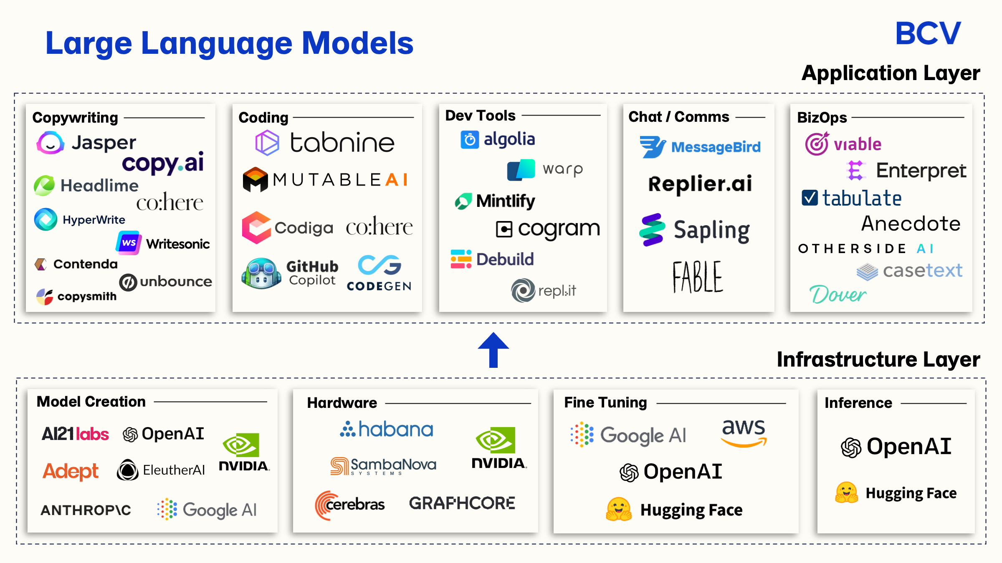
Notes:
https://www.labellerr.com/blog/an-introduction-to-large-language-models-llms/

Slide 29
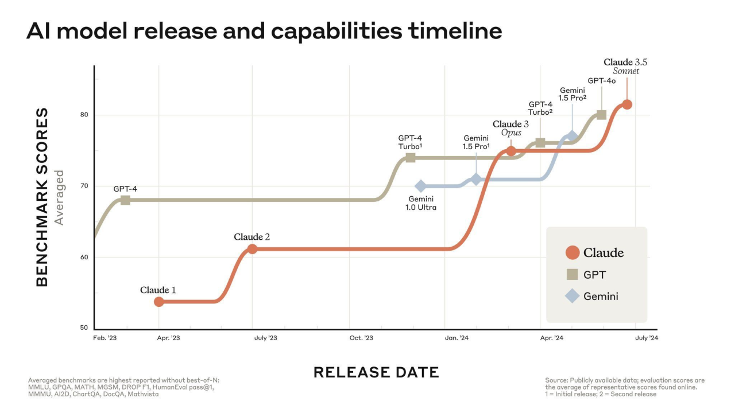

Slide 30
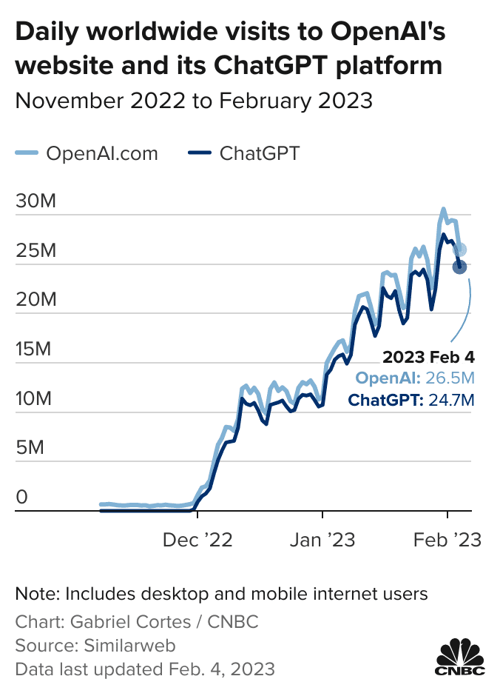
Why Chatgpt Become So Popular?
Quick to Adopt New AI Development
Marketing and Branding: Media attention
Design and Architecture
Bert
Understanding context
masked language model objective
sentiment analysis
question answering
named entity recognition
Chatgpt
generative tasks: unidirectional (autoregressive) approach

Slide 31
How to Leverage New Developments in AI ?
Develop Your Model from Scratch
A Custom AI Model
API

Slide 32
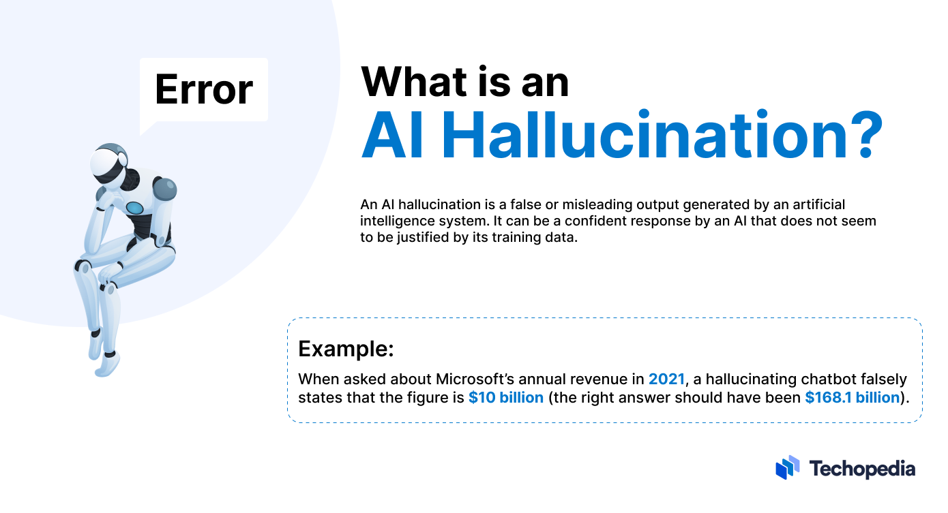

Slide 33
Steps in Transformer Architecture
Tokenization
Assigning IDs to Each Token
Input Embeddings
Positional Encoding
Multi-Headed Self-Attention Mechanism
Calculate Q, K, V
Calculate Attention Scores
Transform by dividing square root of model dimension – Attention Scales
Transform by softmax – Attention weights
Calculate Attention output

Slide 34
Why to Explore These Steps?
Racial Bias
Gender Bias
Cultural Bias
Stereotypical Associations
Stereotypes in Generated Text
Differential Sentence Completion
Biased Sentiment Scores

Slide 35

Tokenization and Token IDs
Input: “the cat sat”
Tokens: [“the”, “cat”, ”sat”]
Token IDs: [1996, 4937, 1491]

Slide 36
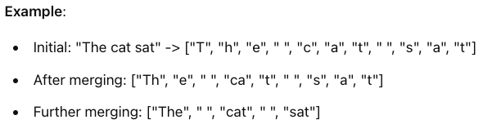
Understanding Tokenization and Tokens
Word-level Tokenization
Character-level Tokenization
Subword-level Tokenization
Byte Pair Encoding (BPE): GPT
WordPiece: BERT

Slide 37
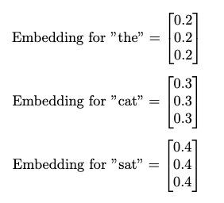
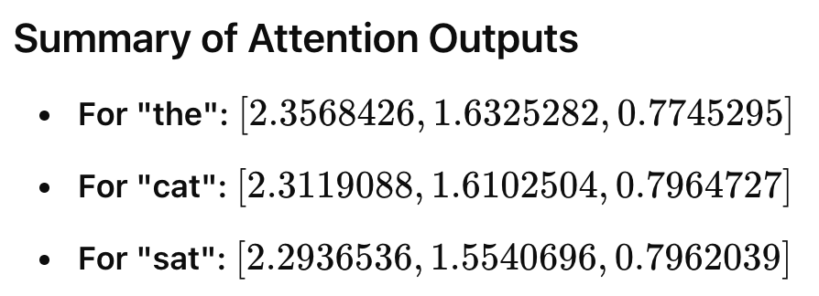
From Embedding Layer to Attention Outputs

Slide 38
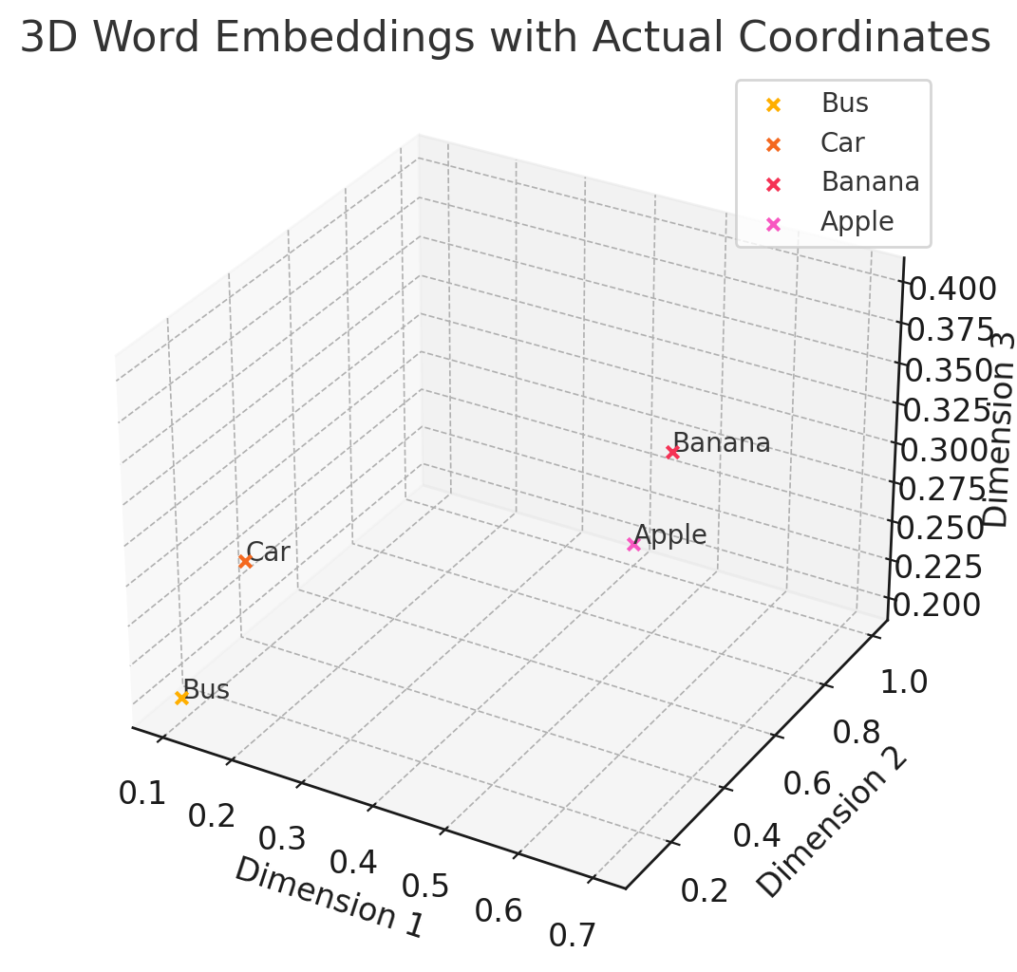
What Are Embeddings? Semantics, Semantics, Semantics!
Bus: (0.1, 0.1, 0.2)
Car: (0.2, 0.1, 0.3)
Banana: (0.7, 0.3, 0.4)
Apple: (0.4, 1.0, 0.2)

Slide 39

Embedding Visualization

Slide 40
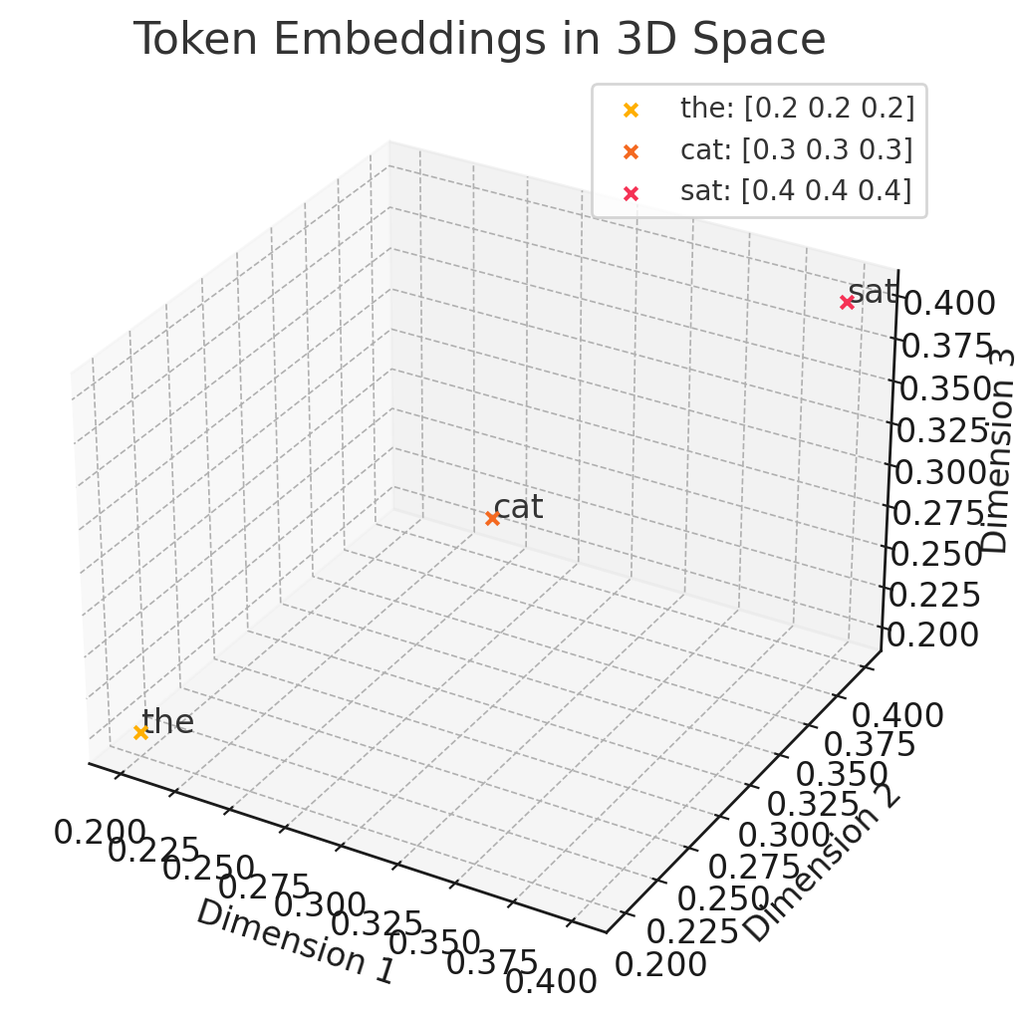
Input Embeddings
“the” is at (0.2, 0.2, 0.2)
“cat” is at (0.3, 0.3, 0.3)
“sat” is at (0.4, 0.4, 0.4)

Slide 41
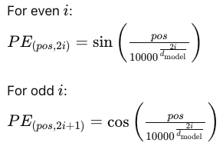
Positional Encodings
Calculate Positional Encodings for Each Position in the Sequence
Retain order of tokens
Our Sequence: “the cat sat”
The => Position 0
Cat => Position 1
Sat => Position 2

Slide 42
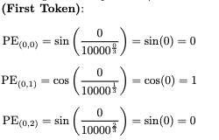
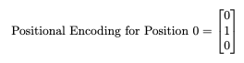
Let’s Get Positional Encodings for First Token

Slide 43
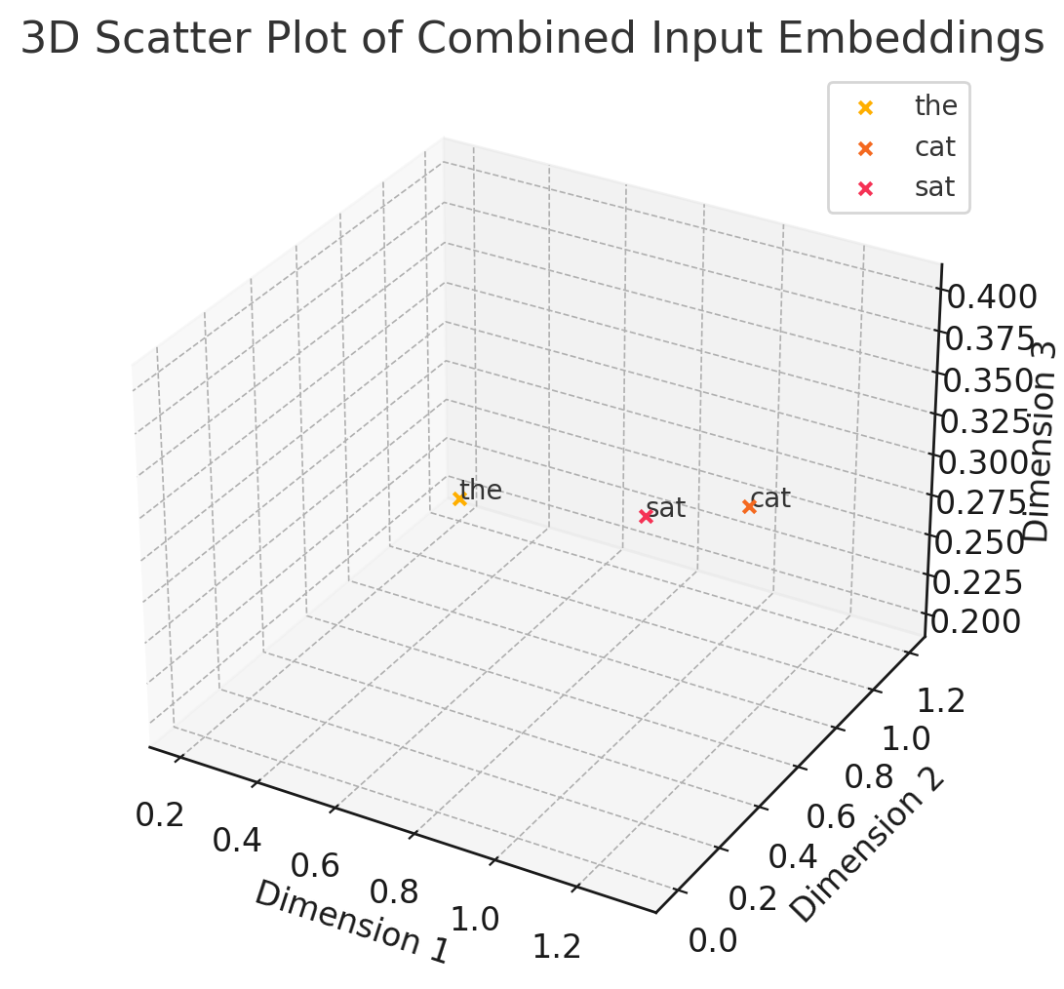
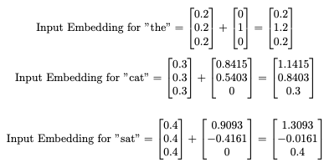
Combine Input Embeddings and Positional Encodings

Slide 44
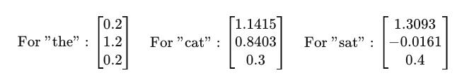
So far we have got combined embeddings We will come back to this

Slide 45
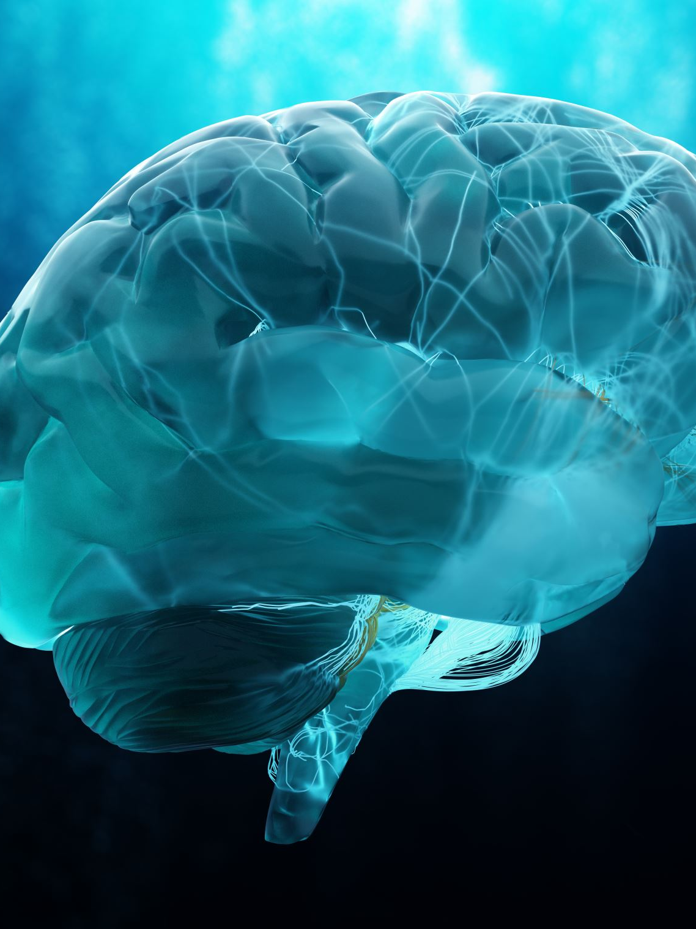
Understanding Attention
”In its most generic form, attention could be described as merely an overall level of alertness or ability to engage with surroundings”.
Attention in Psychology, Neuroscience, and Machine Learning
“The human brain attends to salient visual features at different neuronal stages”
“The human brain does so by relying on attention, such that it dynamically stores in memory the information that the human subject most pays attention to.”

Slide 46
Attention-Based System in Machine Learning
Distributed representations
Read data and convert it into sequence of vectors, each representing a word’s meaning and context.
Memory
A list of feature vectors storing the output of the reader
Exploiter process
attention mechanism assigns different weights to these vectors based on task

Slide 47
Self-Attention in Transformer Architecture
Captures Long-Range Dependencies
Parallelization
Multi-Head Self-Attention
Scalability
Query, Key, Value

Slide 48
Q, K, V Matrices
Query (Q): What do we want to find out?
can be thought of as a set of questions we want to ask about the text
Key (K): How do we match our questions to the text?
a set of tags for the text
Value (V): What information do we need to retrieve?
Value matrix holds the actual information or content of the text

Slide 49

Let’s Explore One Example: “The cat sat on the mat.”
Query (Q): You want to know "What is the subject of the sentence?”
Key (K): You look at each word in the sentence and evaluate its relevance to the subject.
“The” (low relevance)
“cat” (high relevance, likely the subject)
“sat” (action, moderate relevance)
“on” (preposition, low relevance)
“the” (low relevance)
“mat” (object, moderate relevance)
Value (V): we gather the actual words based on their relevance to answer the query. In this case, the word “cat” is highly relevant, so it becomes the focus of our attention.

Slide 50
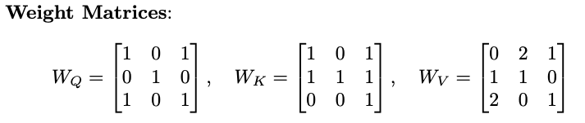
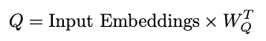
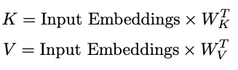
So far we have got combined embeddings. Next, we will obtain Q, K, V for Each Token

Slide 51
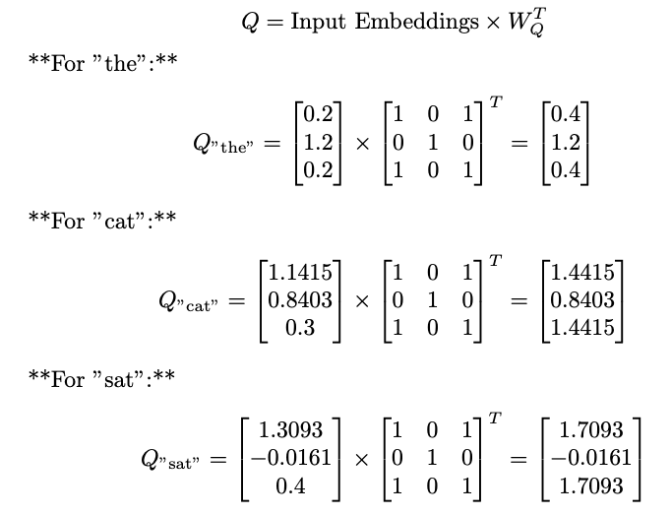
Q for All Tokens

Slide 52
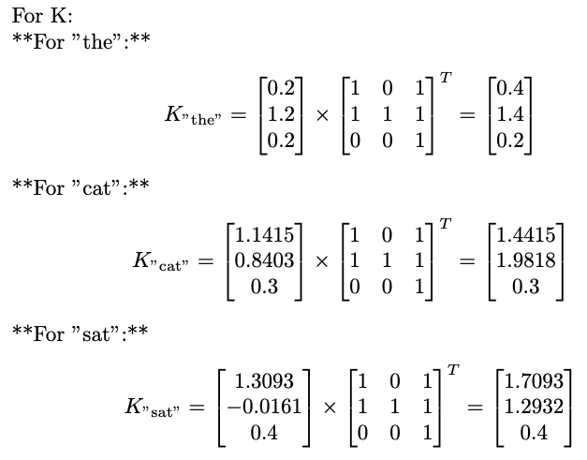
K for All Tokens

Slide 53
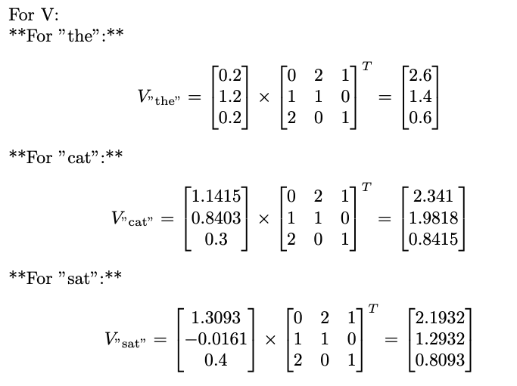
V for All Tokens

Slide 54
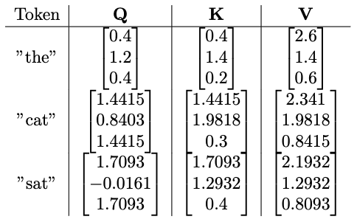
Q, K, V for All Tokens

Slide 55
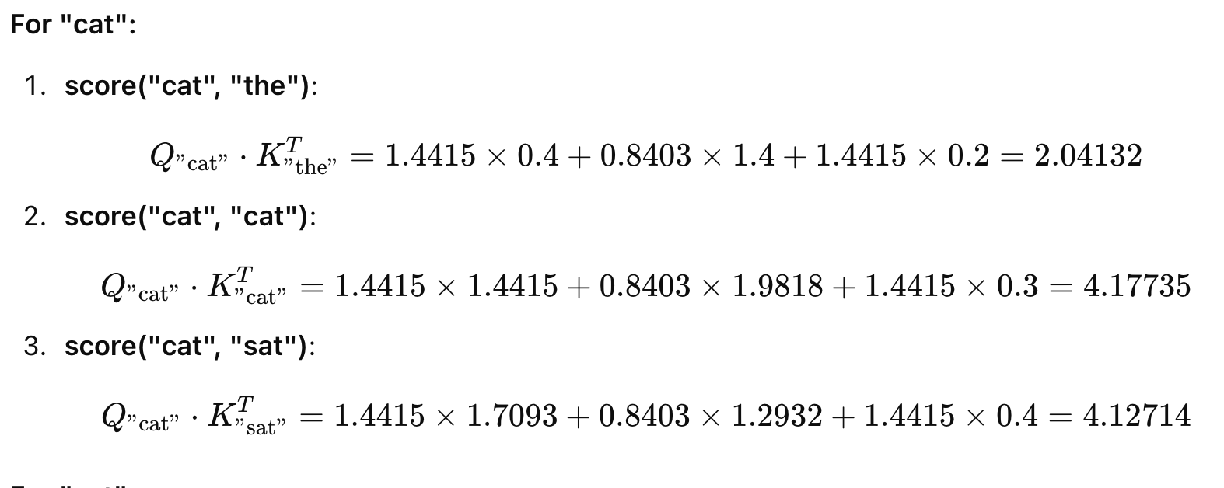
Attention Scores: How Much Each Token Attends Itself and Other Tokens

Slide 56
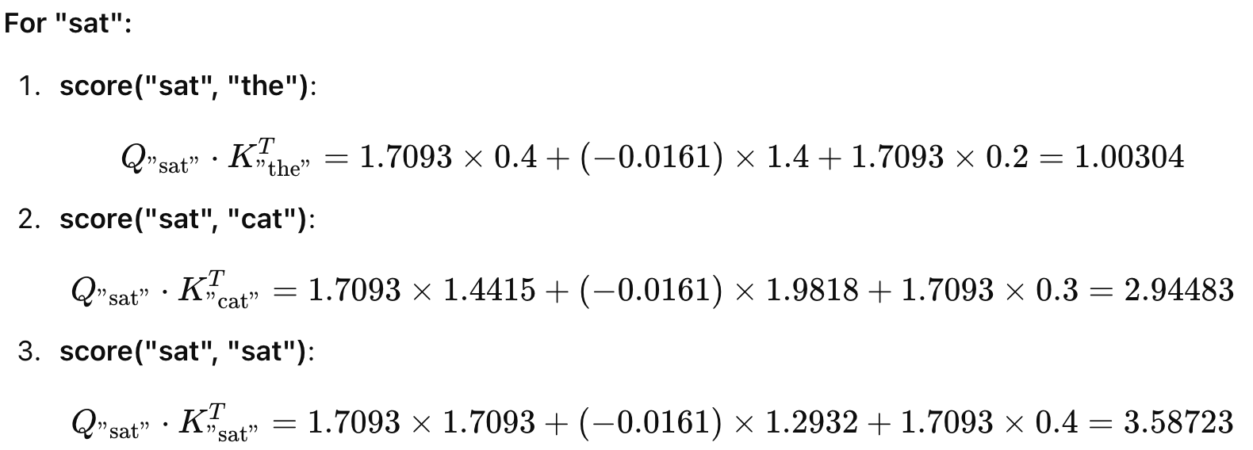

Slide 57
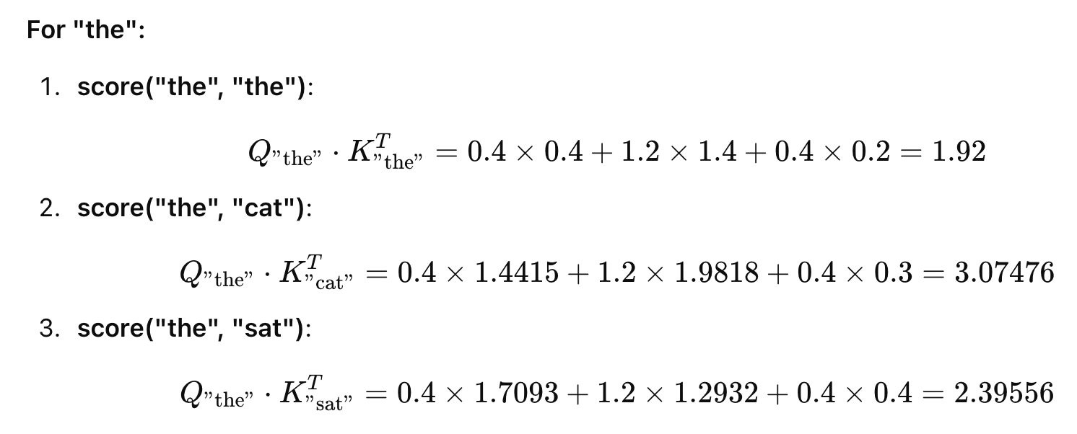

Slide 58
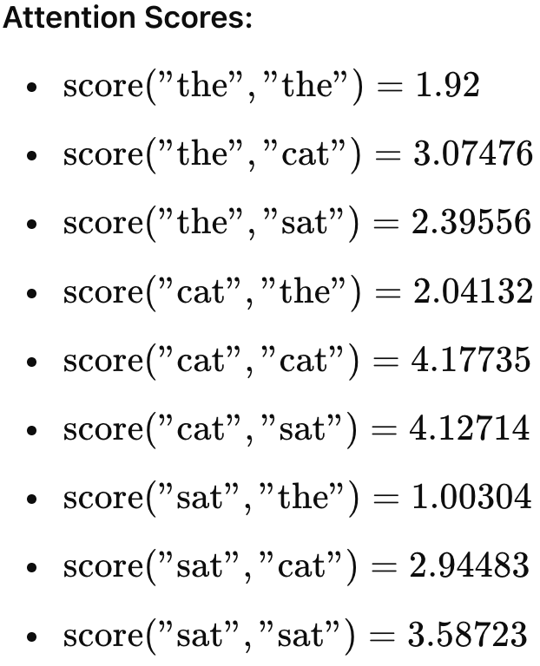

Interpretation of Attention Scores

Slide 59



Further Transformation on Attention Scores

Slide 60

Attention Outcomes

Slide 61


Slide 62
Multi-Head Attention: Divide Dimensions among Heads
Different Representations
Fine-Grained Attention
Contextual Embeddings
Long-Range Dependencies
Parallel Computation

Slide 63

“I am here. You don’t need all these calculations to find me.”

